Slide 1

SWE-4739: Embedded Software Development
Credit: 3.00
Lec-4: Embedded System-design challenges
Thanks to: Md. Nazmul Haque
Creating Global Citizens Rooted with Islamic Values

Slide 2

Contents
Design challenges of embedded systems
Creating Global Citizens Rooted with Islamic Values
‹#›

Slide 3
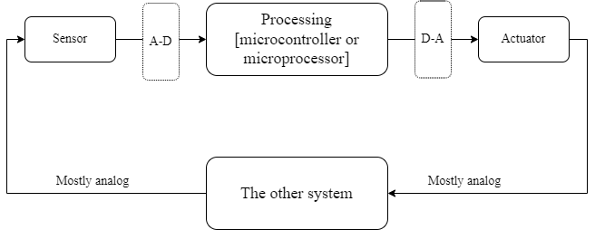
Architecture of Embedded System (ES)
Creating Global Citizens Rooted with Islamic Values
‹#›

Slide 4
Real Time Systems (RTS)
RTS
Hard RTS
Stringent time constrained
Nuclear power plant, airplane landing
Soft RTS
Quality of Service reduced
No catastrophe
Creating Global Citizens Rooted with Islamic Values
‹#›

Slide 5
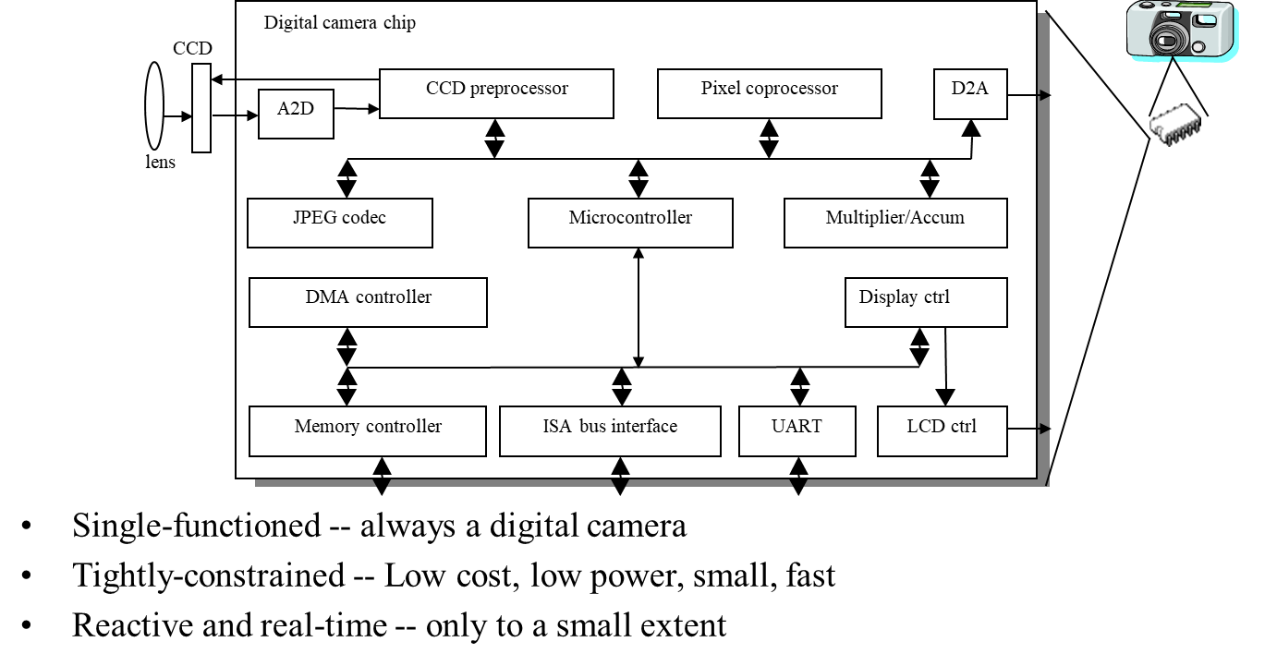
An ES example - a digital camera
Creating Global Citizens Rooted with Islamic Values
‹#›

Slide 6
Reactive system vs transformational system
Reactive system
React to an event: Shutter a digital camera
Transformational system
Image processing: segmentation, enhancement
Creating Global Citizens Rooted with Islamic Values
‹#›

Slide 7
Design challenges - optimizing design metrics
Obvious design goal:
Construct an implementation with desired functionality
Key design challenge:
Simultaneously optimize numerous design metrics
Design metric
A measurable feature of a system’s implementation
Optimizing design metrics is a key challenge
Creating Global Citizens Rooted with Islamic Values
‹#›

Slide 8
Design challenges - optimizing design metrics
Common metrics
Unit cost: the monetary cost of manufacturing each copy of the system, excluding NRE cost
NRE cost (Non-Recurring Engineering cost): The one-time monetary cost of designing the system
Size: the physical space required by the system
Performance: the execution time (latency) or throughput of the system
Power: the amount of power consumed by the system
Flexibility: the ability to change the functionality of the system without incurring heavy NRE cost
Creating Global Citizens Rooted with Islamic Values
‹#›

Slide 9
Design challenges - optimizing design metrics
Common metrics (continued)
Time-to-prototype: the time needed to build a working version of the system
Time-to-market: the time required to develop a system to the point that it can be released and sold to customers
Maintainability: the ability to modify the system after its initial release
Correctness, safety, many more
Creating Global Citizens Rooted with Islamic Values
‹#›

Slide 10
NRE and unit cost metrics
Costs:
Unit cost: the monetary cost of manufacturing each copy of the system, excluding NRE cost
NRE cost (Non-Recurring Engineering cost): The one-time monetary cost of designing the system
total cost = NRE cost + unit cost * # of units
per-product cost = total cost / # of units
= (NRE cost / # of units) + unit cost
Creating Global Citizens Rooted with Islamic Values
‹#›

Slide 11
NRE and unit cost metrics
Example
NRE=$2000, unit=$100
For 10 units
total cost = $2000 + 10*$100 = $3000
per-product cost = $2000/10 + $100 = $300
Creating Global Citizens Rooted with Islamic Values
‹#›

Slide 12
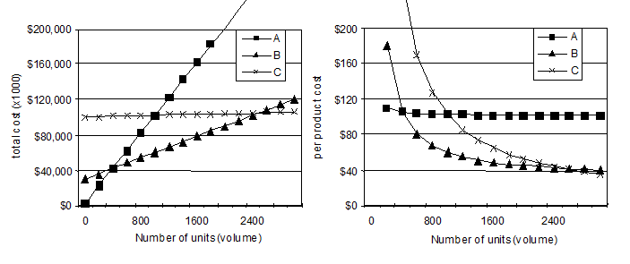
NRE and unit cost metrics
Compare technologies by costs -- best depends on quantity
Technology A: NRE=$2,000, unit=$100
Technology B: NRE=$30,000, unit=$30
Technology C: NRE=$100,000, unit=$2
Creating Global Citizens Rooted with Islamic Values
‹#›

Slide 13
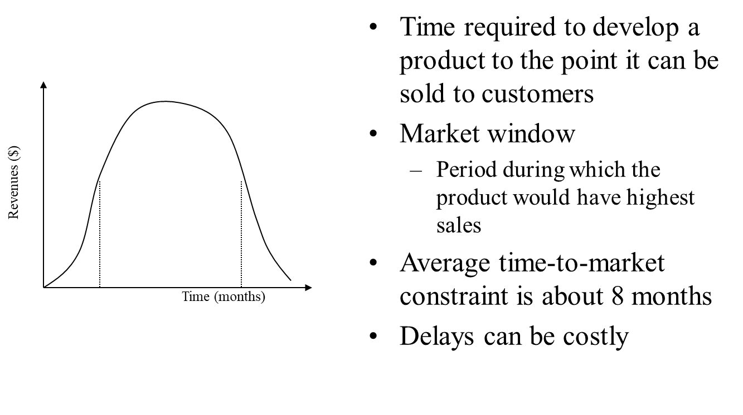
Time-to-market: a demanding design metric
Creating Global Citizens Rooted with Islamic Values
‹#›

Slide 14
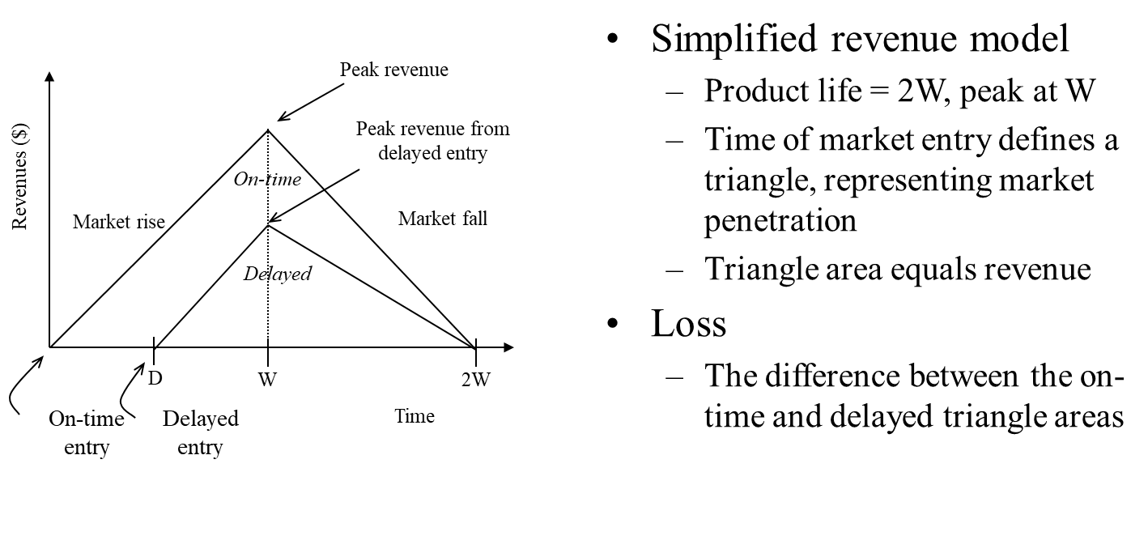
Losses due to delayed market entry
Creating Global Citizens Rooted with Islamic Values
‹#›

Slide 15
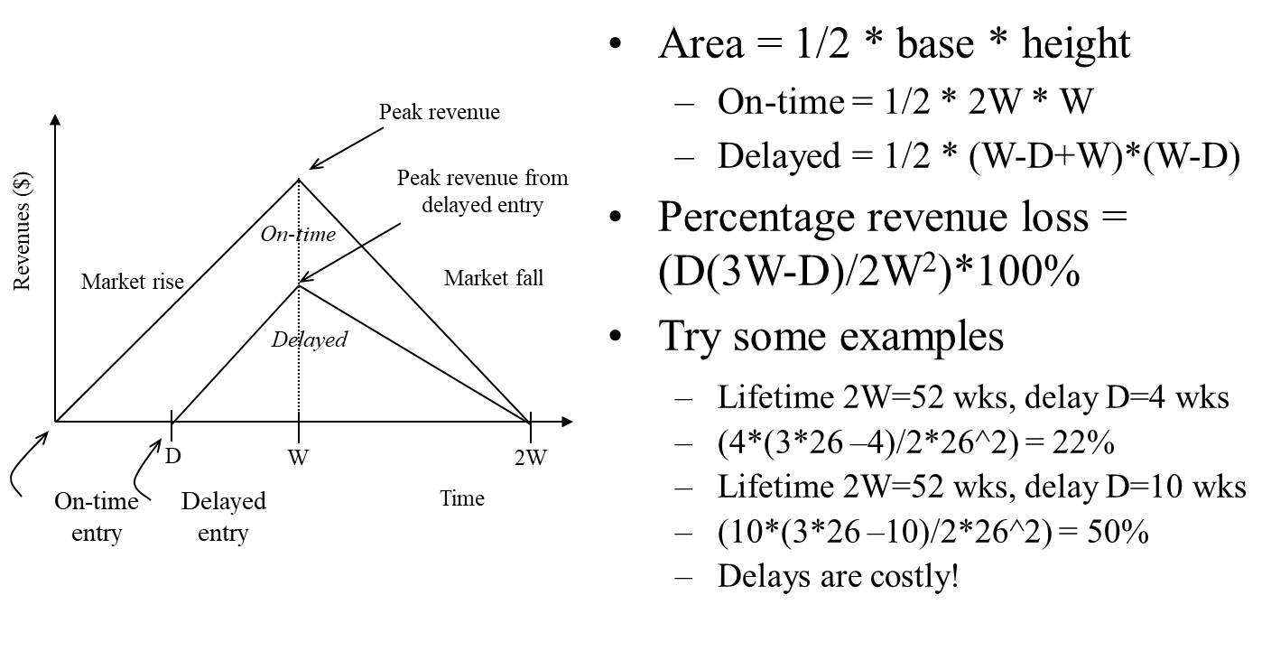
Losses due to delayed market entry (cont.)
Creating Global Citizens Rooted with Islamic Values
‹#›

Slide 16
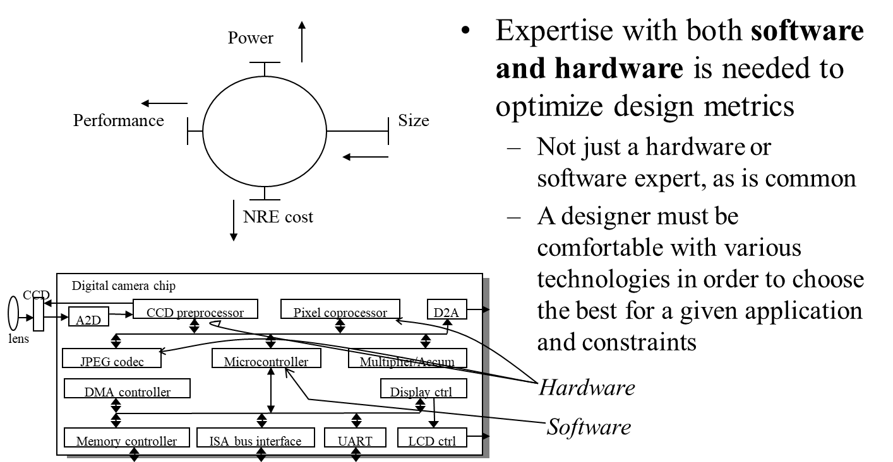
Design metric competition -- improving one may worsen others
Creating Global Citizens Rooted with Islamic Values
‹#›

Slide 17
Reference(s)
A Unified Hardware/Software Introduction,Frank Vahid and Tony Givargis,Frank Vahid and Tony Givargis
Creating Global Citizens Rooted with Islamic Values
‹#›

